Slide 1
Agile Development Best Practices:
Code Smells and Refactoring
Darryl Gebert
Solutions Architect

Slide 2
Agenda
Introduction
Software Code Issues
Code Smells
Refactoring
The Workflows of Refactoring
Summary, Resources

Slide 3
Part I:
Introduction

Slide 4
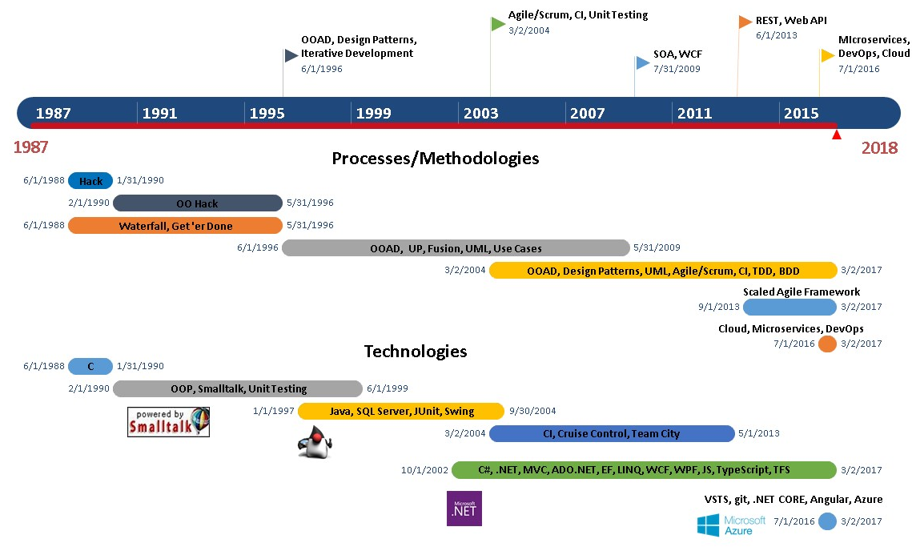
Darryl Gebert – Career Timeline Summary

Slide 5

Why Are We Here
You are a good developer.
You want to be a better developer.
Building quality
Software systems are often large and complex
Construction requires best Agile / OO Development skills and practices
Stakeholders , Product Owners = customers, features, schedule
Our job = Defend the Code

Slide 6
Part II:
Software Code Issues

Slide 7

It Starts Out As Clean Code
Starts out with good clean code. Things move fast, expectations and perceptions are set.
Add new features.
Development team grows.
Developers leave.
New developers come onboard.
More features, fixes, enhancements, etc.
Unit testing lags or grows stale.
Complexity grows. Code Bloats.
Technical debt accumulates.

Slide 8

What Does A Mess Look Like?
BRACE YOURSELVES
Extreme Technical Debt
YOU’RE ABOUT TO SEE SOME TECHNICAL DEBT

Slide 9
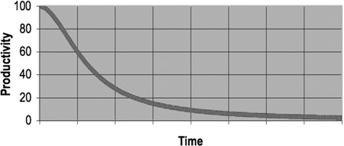
Total Cost of Owning a Mess
Been programming for awhile?
Been slowed down by a large complex messy codebase?
Over time, codebase grows large, more difficult to clean up.
As mess builds:
Productivity of team decreases
Code grows more $$$$ to maintain over time

Slide 10

Working With Code
20%
Write New Code
80%
Read Code to:
- fix bugs
- optimize
- etc

Slide 11

Cost of Software Maintenance
50% of the cost of software maintenance is spent trying to understand the existing code base. (Gartner)

Slide 12
Principles of Good OO Programming
KISS Design principle
Simplicity is key
Avoid unnecessary complexity and over-engineering.
SOLID
Single Responsibility Principle
Open/Closed Principle
Liskov Substitution Principle
Interface Segregation Principle
Dependency Principle

Slide 13


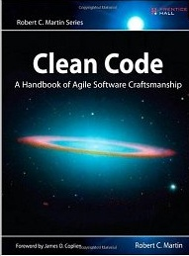


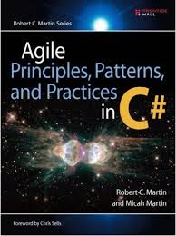

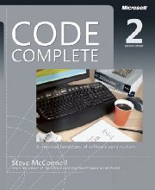
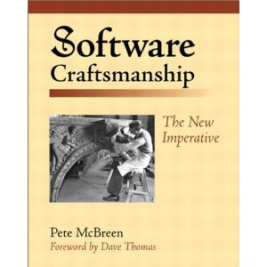
Best OO and Agile Development Practices
SOLID principles
OO Principles
Encapsulation
Polymorphism
Abstraction
Inheritance
Design Patterns
GRASP (General Responsibility Assignment Software Patterns)

Slide 14

The Foundation of Good Software Design
Majority of principles, patterns, and practices are based on this:
Coupling
Cohesion

Slide 15
Part III:
Code Smells

Slide 16
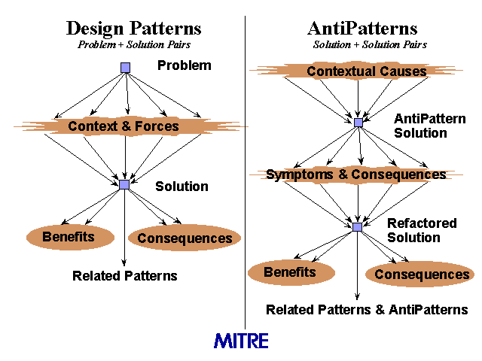
Patterns and AntiPatterns

Slide 17
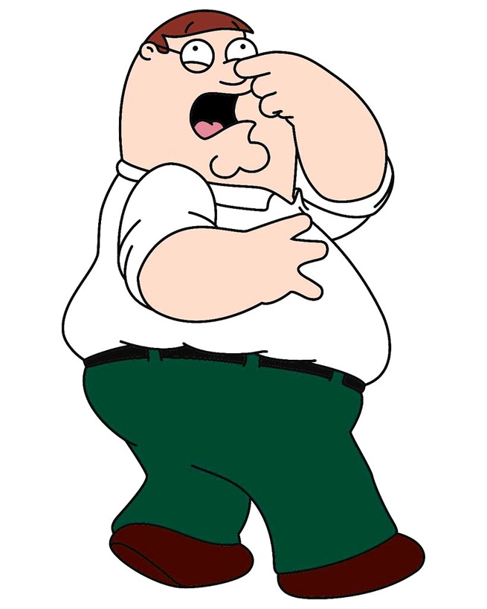
Code Smells - AntiPattern
Any symptom in the source code of an application of system that indicates a deeper problem
Warning signs in code which indicate weakness in design
A design that duplicates, complicates, bloats or tightly couples code
Even great code will start to smell bad over time with fixes and enhancements

Slide 18
Code Smell Categorizations
Bloaters
Code, methods, classes that have increased to gargantuan proportions that they are hard to work with.
Accumulates over time as codebase evolves
OO Abusers
Incorrect application of OO principles
Change Preventers
Change in one place results in changes in many other places
Dispensables
Something pointless and unneeded which coups unnecessary complexity
Couplers
Contribute to excessive coupling between classes
Shows what happens if coupling is replaced by excessive delegation

Slide 19
Code Smells (Fowler et al)
Alternative Classes with Different Interfaces
Comments
Dead Code
Data Class
Data Clumps
Divergent Change
Duplicate Code
Feature Envy
God Class
Inappropriate Intimacy
Inappropriate Naming
Incomplete Library Class
Large Class
Lazy Class
Long Method
Long Parameter List
Magic Numbers and Strings
Message Chains
Middle Man
Parallel Inheritance Hierarchies
Primitive Obsession
Refused Bequest
Shotgun Surgery
Speculative Generality
Switch Statements
Temporary Field

Slide 20
Code Smells by Category
Bloaters
OO Abusers
Change Preventers
Dispensables
Couplers
Large Class
Long Method
Long Parameter List
Primitive Obsession
Data Clumps
God Class
Switch Statements
Temporary Field
Inappropriate Naming
Refused Bequest
Alternate Classes with Different Interfaces
Divergent Change
Shotgun Surgery
Parallel Inheritance
Comments
Duplicate Code
Lazy Class
Data Class
Dead Code
Speculative Generality
Feature Envy chains
Inappropriate Intimacy
Message Chains
Middle Man
Incomplete Library Class

Slide 21
Code Sample (Java)
public abstract class AbstractCollection implements Collection {
public void addAll(AbstractCollection c) {
if (c instanceof Set) {
Set s = (Set)c;
for (int i = 0; i < s.size(); i++) {
if (!contains(s.getElementAt(i))
add(s.getElementAt(i);
}
} else if (c instanceof List) {
List l = (List)c;
for (int i = 0; i < l.size(); i++) {
if (!contains(l.get (i))
add(l.get(i);
}
} else if (c instanceof Map) {
Map m = (Map)c;
for (int i = 0; i < s.size(); i++) {
add(m.keys[i], m.values[i]);
}
}
}
}

Slide 22
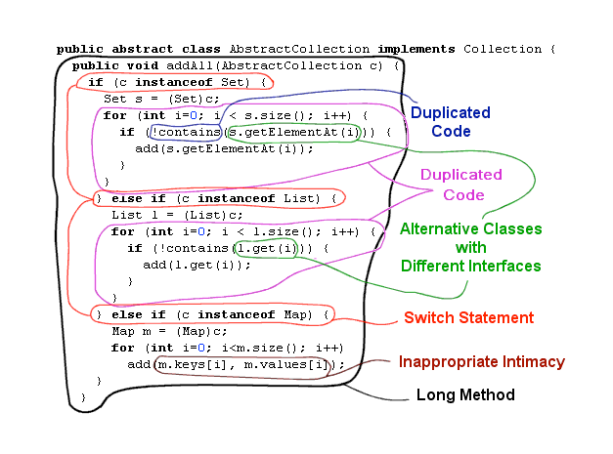

Code Smell Analysis

Slide 23
Inappropriate Naming
Names are everywhere in software
Solutions, project, source files, classes, interfaces, methods, variables
Use Intention-Revealing names (from Kent Beck's "Smalltalk Best Practice Patterns")
DO: Name methods after what the method does
DON’T: Name methods after how it works.
Class names should be nouns
They describe what its purpose is.
Eg. Practice, Account, UserController,
Method names should be verbs describing what it does, not how
Bad: GetCustomersListWithAllCustomersIncludedWithoutFilter()
Good: GetAllCustomers()

Slide 24
Inappropriate Naming - Fix
Use Intention-Revealing Names
Class, Method, Variable names should be clear.
They should help tell a story
Bad:
elapsed
createdDays
modifiedDays
age
Good:
elapsedTimeInDays
daysSinceCreation
daysSinceModified
fileAgeInDays

Slide 25
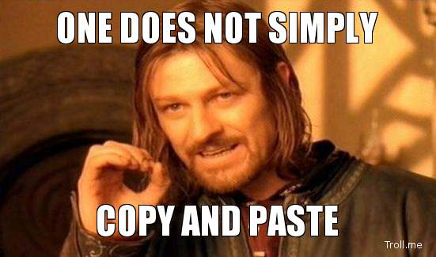
Duplicated Code
DRY
(Don’t Repeat Yourself)
vs
WET
(We Enjoy Typing)
Apply the “Rule of 3”
- If you repeated something 3 times, then refactor

Slide 26
Duplication (continued)
Examples
Identical code (copy/paste)
Switch/case (or if/else) chains
Similar algorithms
Missed opportunity for abstraction
Design patterns and OO itself are strategies for eliminating duplication

Slide 27
Long Method
Too hard to comprehend
Many conditions and loops, often nested > 3 levels
Have to scroll to read method
Often has comments in it to explain sections
Violates Single Responsibility Rule – its doing too much
Short method is easier to read, easier to troubleshoot, and Test
Give methods a good intention-revealing name
If you feel the need to add comments, make a method

Slide 28
Large Class
A class that contains many fields/methods/lines of code.
It violates the single responsibility pattern, and is doing too much.
A Large Class is difficult to:
Read
Understand
Troubleshoot
Change without breaking something
Ask yourself:
Does the class contain too many responsibilities?
Can the class be restructured or broken into smaller classes?

Slide 29
Switch Statements
Complex switch operator or
Sequence of if/else statements.
An Object Oriented abuser
OO - relatively rare use of switch /case operators.
Code for a single switch is often scattered in different places.
When new condition is added, have to find/modify all switch code
As a rule of thumb, when you see switch you should think of applying:
Factory design pattern
Interface with polymorphism.

Slide 30
Magic Numbers (and Strings)
Your code uses a number (or string) that has a certain meaning to it.
Eg.
double PotentialEnergy(double mass, double height)
{
return mass * height * 9.81;
}
Refactor – give context and meaning to value:
const double GRAVITATIONAL_CONSTANT = 9.81;
double PotentialEnergy(double mass, double height)
{
return mass * height * GRAVITATIONAL_CONSTANT;
}

Slide 31
Comments
A sweet smell - “Code Deodorant”
Motivations:
Hoarding, or a “soft” delete of unwanted code, with implicit intent that it you want to resurrect it someday.
VCS keeps history
Often referred to as “scar tissue”
Failure to express an idea in the code, so you explain it
Code should be self documenting, intention-revealing
Feel the need to write a comment? First try to refactor the code so that any comment becomes unnecessary
If unsure, mark with a “TO-DO” and create a refactoring user story

Slide 32
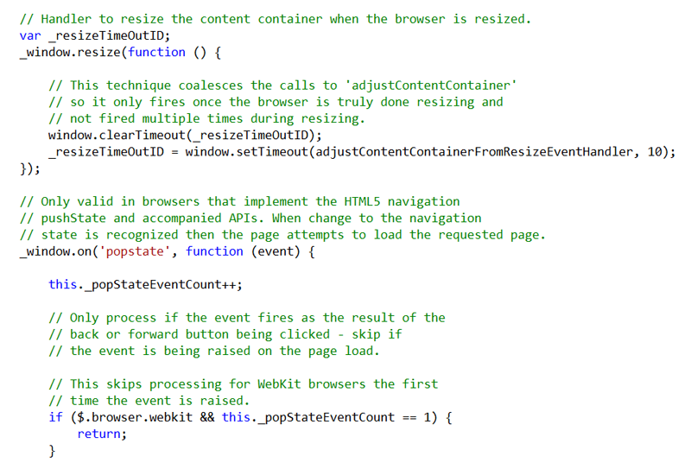
Comments - Samples

Slide 33

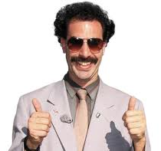
Comments – Samples (con’t)
Explaining what code does
This?
// Check to see if the employee is eligible
// for full benefits
if (Employee.PayRate = PayRate.Hourly
&& Employee.Age > 65)
{
// do something
}
Or This?
if (Employee.IsEligibleForFullBenefits)
{
// do something
}
Property

Slide 34
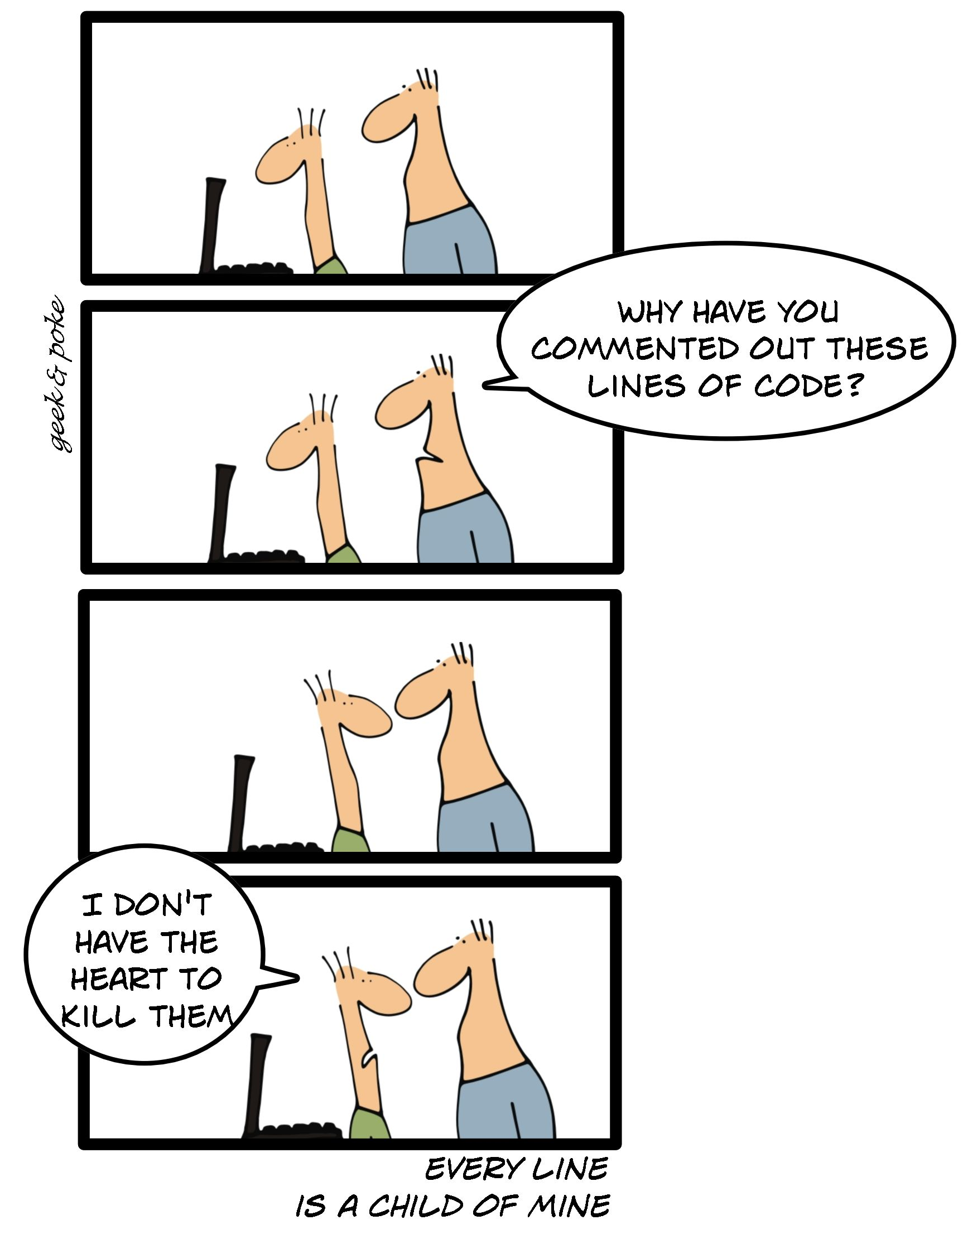
Commented Out Code – “Scar Tissue”
//* // * Working Version Need to berify
//public class LogEntryQueue<T> where T:class
//{
// readonly Queue<T> _queue = new Queue<T>();
// readonly AutoResetEvent _event = new AutoResetEvent(false);
// readonly Action<T> _callback = null;
// public LogEntryQueue(Action<T> callback)
// {
// _callback = callback;
// }
// public void Add(T entry)
// {
// lock (_queue)
// {
// _queue.Enqueue(entry);
// }
// }
// private void Run()
// {
// int count = 0;
// T entry = null;
// (new Thread(() =>
// {
// while (true)
// {
// try
// {
// . . . ETC . . .
// // * */
No need for this, VCS maintains history

Slide 35
Good and Bad Comments
Public API Comments
Legal
Explanation of Intent
Warning for Consequences
Real TODO Comments
Redundant Comments
Noise Comments
Position Markers
Closing Brace Comments
Commented-Out Code
Obsolete Comments
Code Step-by-Step

Slide 36
In the world of maintainability - Smaller is Better
Smaller Methods
Smaller Classes
Smaller IF Blocks
Easier to maintain many small (well-named) units rather than one large one.

Slide 37

So It Smells, Now What?
Recognizing bad code does not mean we know how to write clean code
Code Smells are heuristics to suggest when to refactor and what techniques to use.
Bottom Line: If it stinks, change it
Refactoring is usually motivated by detecting a code smell.

Slide 38
Part IV:
Refactoring

Slide 39



Refactoring – What the Experts Say
“The process of changing a software system in such a way that it does not alter the external behavior of the code, yet improves its internal structure.”
- Martin Fowler
“A change to the system that leaves its behavior unchanged, but enhances some nonfunctional quality – simplicity, flexibility, understandability, performance.”
- Kent Beck
“Refactoring may be the single most important technical factor in achieving agility.”
- Jim Highsmith

Slide 40
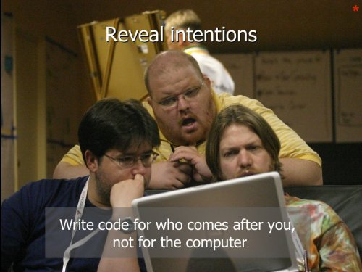
Refactoring- KEY IDEA
“Whenever you have to figure out what code is doing, you are building some understanding in your head. Once you've built it, you should move that understanding into the code so nobody has to build it from scratch in their head again.”
Ward Cunningham
Code Should be written to minimize the time it would take for someone to understand it

Slide 41
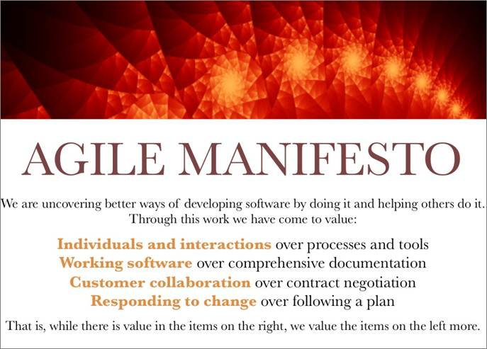
Why Refactor? – Commitment to Professionalism

Slide 42
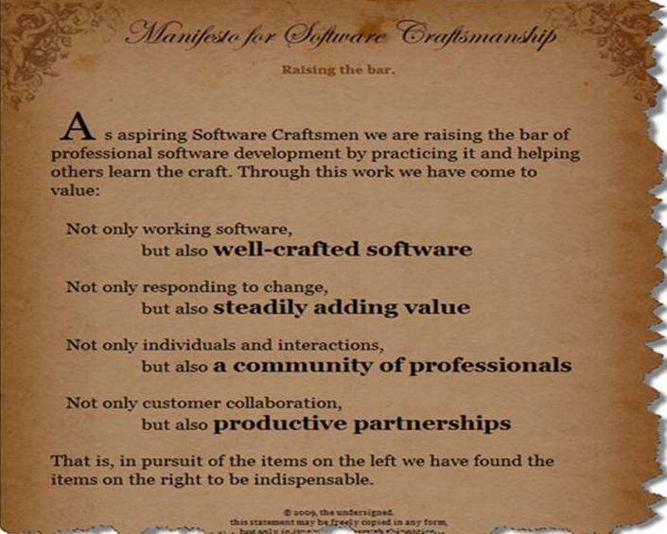
Why Refactor? – Commitment to Professionalism

Slide 43
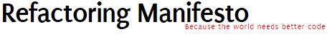
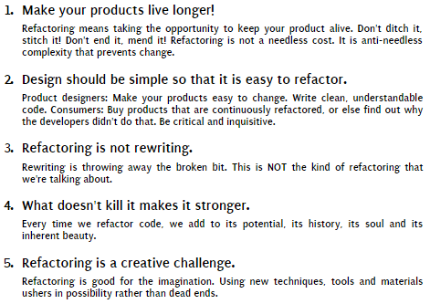

Slide 44
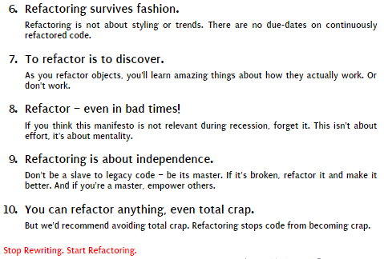

Slide 45
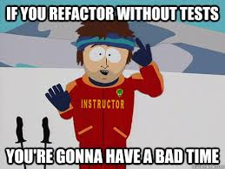
Requirements for Refactoring
Collective code ownership
Coding standards
Simple design
Continuous integration
Rested programmers
Dev Tools
Unit / Integration Tests

Slide 46
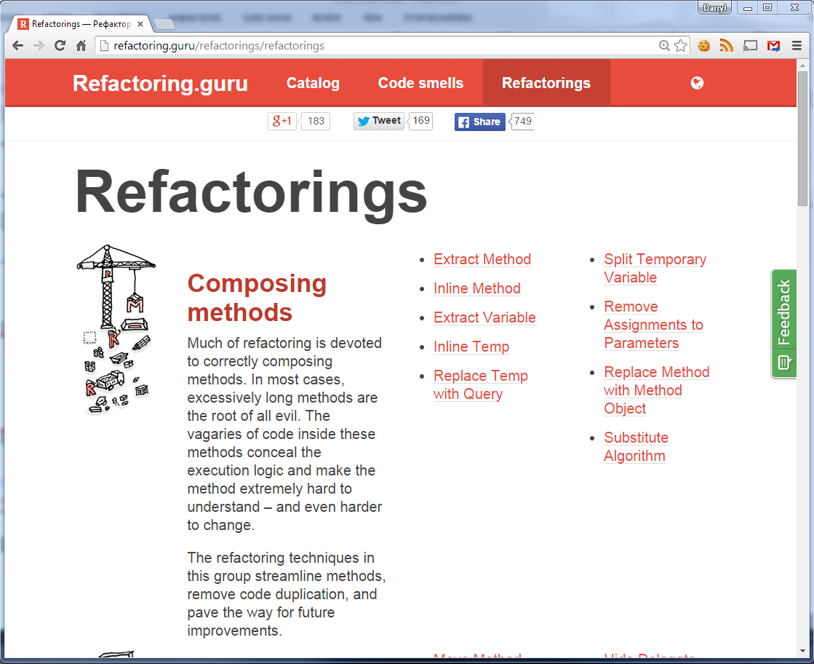
Refactorings Catalog (Fowler)
http://refactoring.guru/refactorings/refactorings

Slide 47
Smell: Large Class
Large Class
Contains too many fields
Contains too many methods
Contains too many lines of code
Refactorings
Violates SRP
Extract Method
Replace Method with Method Object
Decompose Conditional
…

Slide 48
Smell: Long Method
Long Method
Contains too many lines of code
Cannot fit on page is a sign
Has comments to explain itself (“code deodorant”)
Should do one thing, do it well, do it only
Refactorings
Extract Class
Extract Subclass
Extract Interface

Slide 49
Smell: Switch Statements
Complex switch operator or sequence of if/else statements
Rule of Thumb: when you see switch statement, think polymorphism
Refactorings
Extract Method
Move Method
Replace Type Code with Class or Subclass
Replace Type Code with State or Strategy
Replace Conditional with Polymorphism
Replace Parameter with Explicit Methods
Think about factory design patterns to select a created class:
Factory Method
Abstract Factory

Slide 50
Part V:
The Workflows of Refactoring

Slide 51
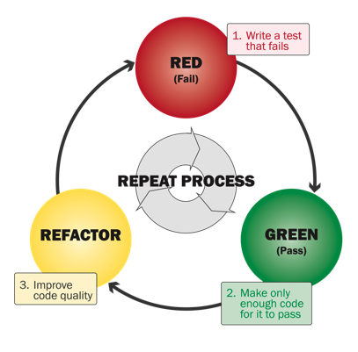
Traditional Refactoring - TDD
Test-Driven Development is often described in terms of the cycle:
red-green-refactor.
Why does TDD cycle make separate steps for first making the test pass and only then making the code clean?

Slide 52
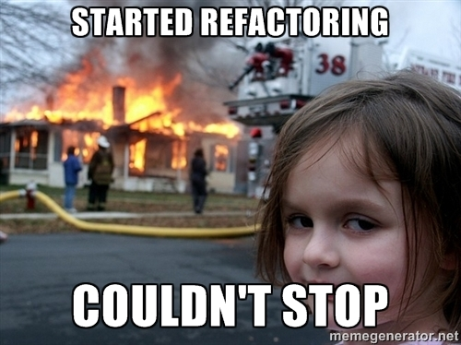
Sure I Refactor, But….

Slide 53


Two Hats of Agile Programming
Adding functionality
Adding new capabilities
Should not change existing code
Adding passing tests, breaking existing tests
Refactoring
Restructuring code, preserve behavior, keeps tests green
Small changes, no debugging
Don't add any tests (unless a test case is discovered)
Only change tests when you absolutely need to in order to cope with a change in an interface.

Slide 54
Swapping Hats
As you develop software, you find yourself swapping hats frequently. Example:
Add a new function.
Realize this would be much easier if code were structured differently.
Swap hats and refactor for a while.
Once code is better structured, swap hats and add new function.
Once new function is working, realize code is awkward to understand, so swap hats again and refactor.
During programming you may swap frequently between hats, perhaps every couple of minutes. But...
You can only wear one hat at a time

Slide 55
Refactoring Workflows
Traditional TDD
Litter-pickup
Comprehension
Preparatory
Planned
Long Term

Slide 56
1. Traditional TDD
Code is working, now concentrate on good design with safe refactoring in small steps
While making test work, focus on functionality, not best code structure

Slide 57

2. Litter-Pickup
Yikes - this code is messy
As we work with a code base, often run into messy areas of code base. Reasons?
Knowledge, requirements, capability of developer at the time
Capable developer on a bad day
Didn't get it right the first time… but who does?
Whatever the reason, by cleaning up code as we work in it, we make things quicker for next developer who works with it.
Or even make it quicker to change now.
Boy-scout rule: Always leave code better than when you found it.

Slide 58

3. Comprehension
What does this big block of code do?
So… Should we extract it into a InitializeFluxCapacitor() method?
Its initializing the flux-capacitor
Whenever you have to figure out what code is doing, it is often a considerable effort.
Once you’ve built this understanding, put it back into the code so future developers don’t have to go through the same effort.

Slide 59
2 & 3. Litter-pickup and Comprehension
Fixing code right away is good move if its simple fix or if fix will make it easier to add feature
See poor code
If refactoring ends up being complex, stash and re-visit later.
Requires stable code-base with tests
Fix Now?
Y
Get to Green
Clean problem
Finish adding feature
N
Finish adding feature
Clean problem
If refactoring is too much, or too difficult to stash, make a note and defer until after feature
Done!
(for now)

Slide 60
4. Preparatory
“Make the change easy, then make the easy change.” - Kent Beck
When starting work on new feature, you realize that existing code structure doesn’t fit well
By refactoring, you make new feature easier to implement.
Good Fit?
Y
Add new feature
N
Refactor to a good fit

Slide 61
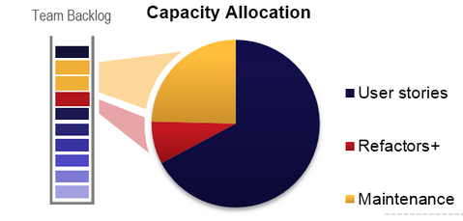
5. Planned
Fixing larger areas of problematic code.
Reschedule refactoring as part of planned work
Technical debt user stories
Planned refactoring
Smell - a sign that team has not done enough refactoring using previous workflows
This is hard to sell to PO because it competes with customer features

Slide 62
6. Long-Term
Some efforts span sprints and even release trains. Examples:
Integration platforms
Change DB persistence framework
Untangling Dependences
Carry out refactorings that move architecture towards end goal
See Branch By Abstraction technique (Fowler)
http://martinfowler.com/bliki/BranchByAbstraction.html
Abstraction layer that supports current and future implementation

Slide 63

How to Refactor – You Need Good Tools
Refactoring by hand is time consuming and prone to error
Visual Studio 2015 (update 3) includes rich refactoring
Resharper offers the most comprehensive refactoring capabilities
https://www.jetbrains.com/resharper/features/
https://www.jetbrains.com/resharper/features/code_refactoring.html
Code quality analysis
Error detection and code smells - warnings, suggestions, hints
Quick-Fixes
Solution-Wide Analysis
Compliance to coding standards

Slide 64
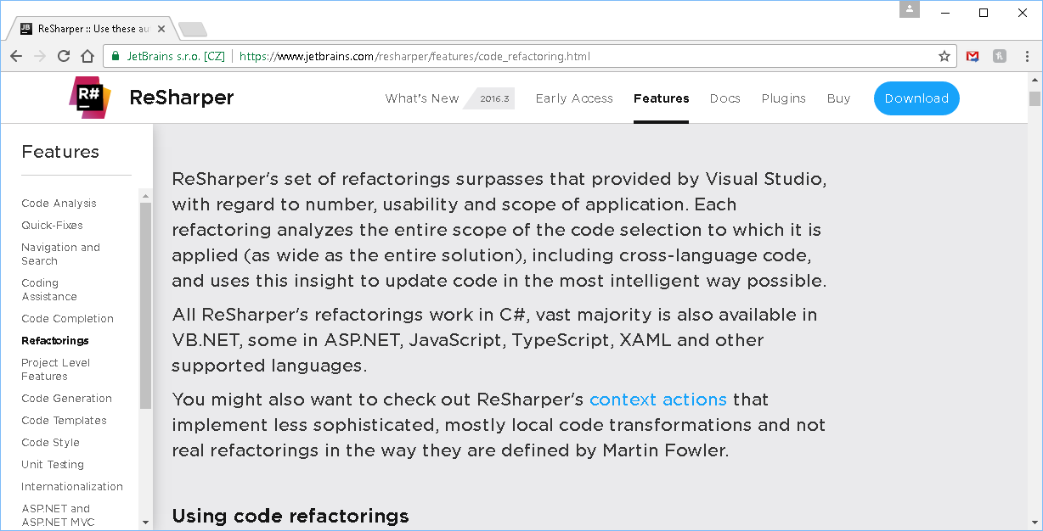
JetBrains Resharper

Slide 65

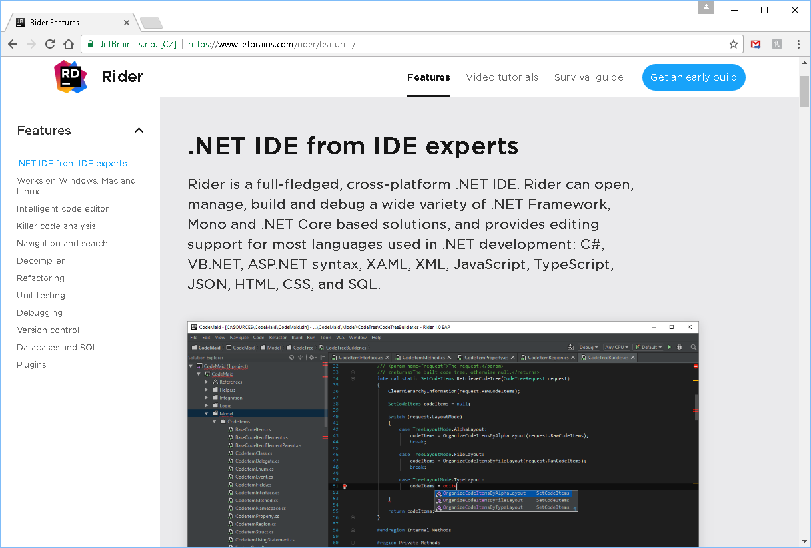
Jetbrains Rider
A cross-platform .NET IDE based on IntelliJ platform and ReSharper

Slide 66
Part VI:
Summary, Resources

Slide 67
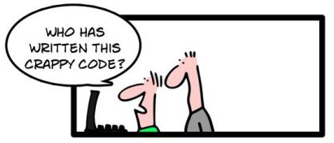
So…. Does Our Code Smell?
First of all…
Its hard enough writing software that works! Be proud of this.
Great code will start to erode over time with fixes and enhancements
Could the code be better? Always!
Don’t be embarrassed, we all write code that could be better
We all cannot improve if unable to admit flaws that need improving

Slide 68
Who wrote this code? (con’t)
Second of all…
Does it matter?
Would knowing the answer actually help us fix the code any faster?
Lastly, the development team owns the code. All of the code
“We did” - as a team we all are responsible for the code under our watch.
Don’t waste time finger pointing.
Just move on and fix it.
We all did it – coding, no tests, no code review, …

Slide 69
Summary - When to Refactor?
When you add functionality
When you need to fix a bug
As you do code reviews
Follow Refactoring workflow patterns – 2 Hats
Always think about code smells and refactorings
But only apply them when they make sense
Sometimes you need a long method… but think about it to make sure!
When a feature is difficult to test, don’t just ask how to test it, but also ask why is it difficult to test

Slide 70
Summary - When Not to Refactor
Test aren’t passing - dangerous
Code should be rewritten
Impending deadlines
unfinished refactoring as technical debt
Taken too far, can lead to incessant tinkering, trying to make it perfect
Databases can be difficult to refactor
Refactoring published interfaces can cause problems for code that uses those interfaces
Don't refactor unless you think you will recoup your investment later by quicker work
Balance refactoring with feature delivery

Slide 71
Being a Professional
Learning
Repetition
Coding Standards and Style
Best Practices
Testing
Learning to say “NO” and Defend the Code
“This task will take me longer than expected because I have to refactor”
Read, Read, Read

Slide 72
Resources
Start here
www.sourcemaking.com
www.refactoring.guru
refactoring.com
Agile, eBooks, Coding Guidelines, etc
Many to choose from, just google.
PluralSight
http://www.pluralsight.com/courses/refactoring-fundamentals
http://www.pluralsight.com/courses/understanding-eliminating-technical-debt
http://www.pluralsight.com/courses/writing-clean-code-humans
Code Smell Cheat sheet:
http://www.industriallogic.com/wp-content/uploads/2005/09/smellstorefactorings.pdf

Slide 73
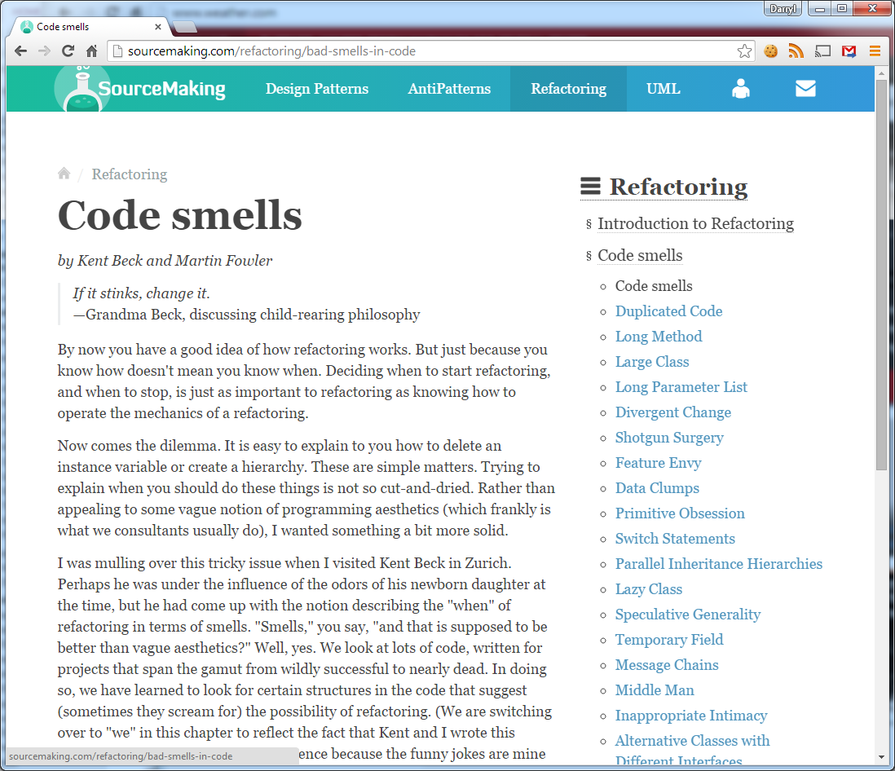
sourcemaking.com

Slide 74
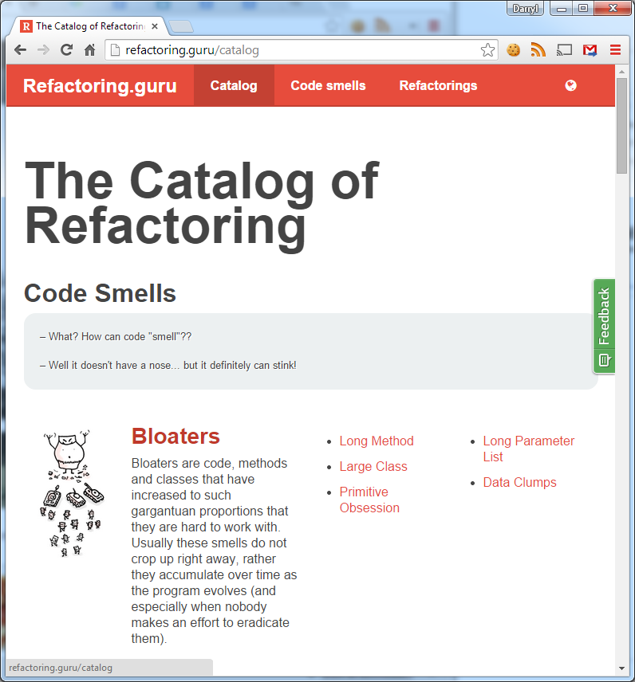
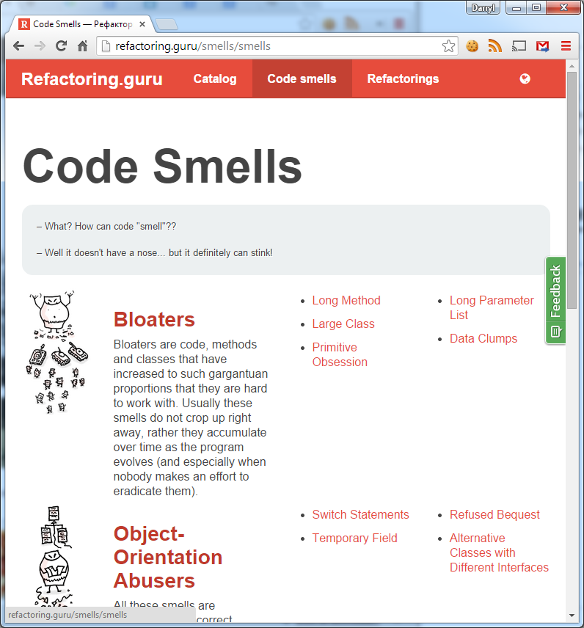
refactoring.guru

Slide 75
Its All About Culture
Make it a part of Team Culture
Unit test
coverage (80% should be minimum goal)
BDD-style
Coding standards – style, naming, structure,
IDE or tools to enforce coding standards
Pull Requests - Code reviews
TDD, Pair Programming
Chip away at code base. Come up with strategies for identifying and fixing these code smells:
Tech Debt User Story: “Smell of the Sprint”
Technical debt is marked with TODO w/ reference to associated tech debt user story in product backlog
Developers choose “code smell of the sprint" user story

Slide 76

Questions?

